Slide 1

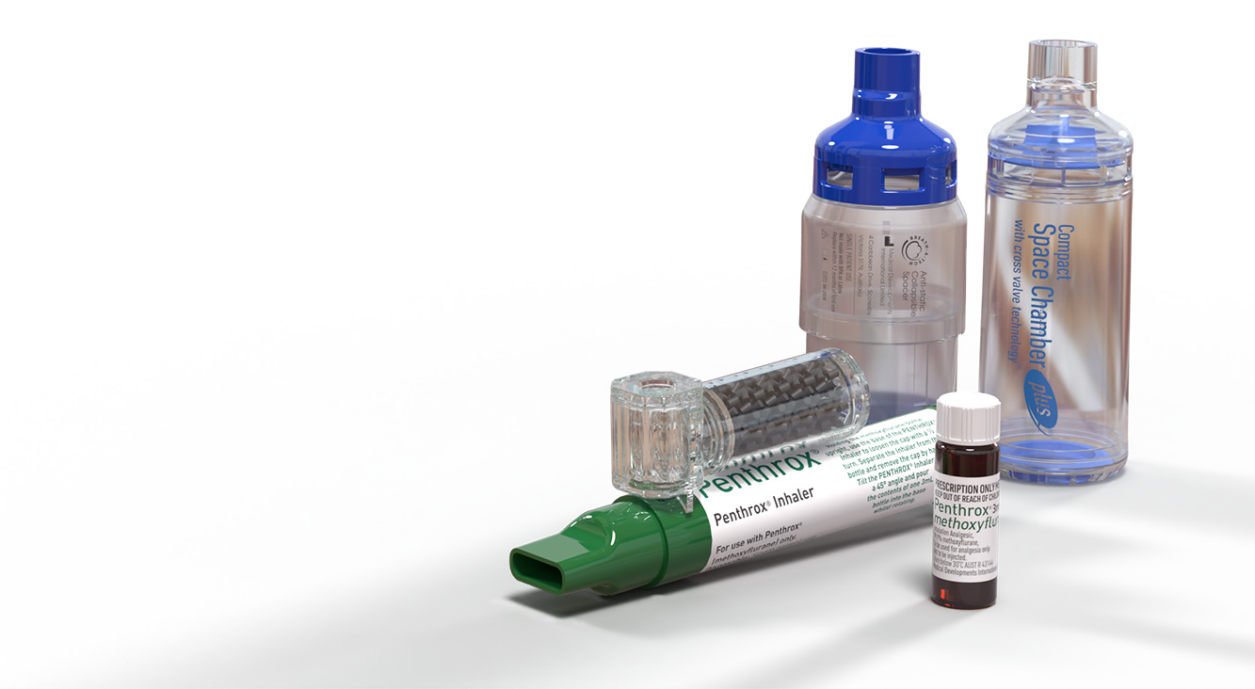
ASX:MVP
FY23 Half Year Results
24 February 2023

Slide 2


Important notice and disclaimer
This presentation contains summary information about Medical Developments International Limited (ACN 108340667) and its related bodies corporate (together, MDI) and MDI’s activities as at the date of this presentation. It is information given in summary form only and does not purport to be complete. It should be read in conjunction with MDI’s other periodic corporate reports and continuous disclosure announcements filed with the Australian Securities Exchange (ASX), available at www.asx.com.au.
This presentation is for information purposes only and is not a prospectus or product disclosure statement, financial product or investment advice or a recommendation to acquire MDI shares or other securities. No representation or warranty, express or implied, is made as to the fairness, accuracy, completeness or correctness of the information, opinions and conclusions contained in this presentation. To the maximum extent permitted by law, none of MDI or its directors, employees or agents, nor any other person, accepts liability for any loss arising from the use of this presentation or its contents or otherwise arising in connection with it, including, without limitation, any liability from fault or negligence on the part of MDI or its directors, employees, contractors or agents.
This presentation contains forward-looking statements in relation to MDI, including statements regarding MDI’s intent, belief, goals, objectives, initiatives, commitments or current expectations with respect to MDI’s business and operations, market conditions, results of operations and financial conditions, products in research and risk management practices. Forward-looking statements can generally be identified by the use of words such as “forecast”, “estimate”, “plan”, “will”, “anticipate”, “may”, “believe”, “should”, “expect”, “project,” “intend”, “outlook”, “target”, “assume” and “guidance” and other similar expressions. The forward-looking statements are based on MDI’s good faith assumptions as to the financial, market, risk, regulatory and other relevant environments that will exist and affect MDI’s business and operations in the future. MDI does not give any assurance that the assumptions will prove to be correct. The forward-looking statements involve known and unknown risks, uncertainties and assumptions and other important factors, many of which are beyond the control of MDI, that could cause the actual results, performances or achievements of MDI to be materially different to future results, performances or achievements expressed or implied by the statements.
Factors that could cause actual results to differ materially include:
the success of research and development activities (including clinical trials);
decisions by regulatory authorities regarding approval of our products as well as their decisions regarding label claims;
competitive developments affecting our products;
the ability to successfully market new and existing products;
difficulties or delays in manufacturing;
trade buying patterns and fluctuations in interest and currency exchange rates / general market conditions;
legislation or regulations, particularly that affect product production, distribution, pricing, reimbursement, access or tax;
litigation or government investigations; and
MDI’s ability to protect its patents and other intellectual property.
Readers are cautioned not to place undue reliance on forward-looking statements, which speak only as at the date of the presentation. Except as required by applicable laws or regulations, MDI does not undertake any obligation to publicly update or revise any of the forward-looking statements or to advise of any change in assumptions on which any such statement is based.
For marketed products discussed in this presentation, please see full prescribing information on our website at www.medicaldev.com
Non-IFRS Financial Information
This presentation uses non-IFRS information including underlying revenue, underlying EBIT and underlying adjustments.These measures are key performance measures used by MDI, the investment community, and peers with similar business portfolios. MDI uses these measures for its internal management reporting as it better reflects what MDI considers to be its underlying performance. Underlying revenue and EBIT are used to measure segment performance and have been extracted from the segment information disclosed in the Condensed Half Year Financial Report.
2

Slide 3


FY23 Half Year
Financial highlights
Revenue
$13.9m¹
+45%
Pain Management Revenue
$7.6m¹
+27%
Respiratory Revenue
$6.2m
+81%
Underlying EBIT
$(8.1)m
+4%
Underlying Adjustments
$11.5m²
(pcp $0.9m loss)
NPAT
$2.7m
(pcp $7.4m loss)
3
Excludes Contract termination revenue of $18.9 million (refer to the Half-Year Consolidated Financial Report)
Underlying adjustments in the current period included: contract termination income arising from the termination of agreements for the distribution of Penthrox in China ($18.5 million); and impairment of capitalised registration costs following the cessation of market activities in China of $6.5 million, and an additional $0.9 million in other countries where revenue opportunities are not being pursued. Underlying adjustments in the prior period related to impairment losses recognised following the Group’s decision to discontinue the Veterinary business ($0.6 million); and finalisation costs for the CSIRO Continuous Flow technology program (0.3 million).

Slide 4
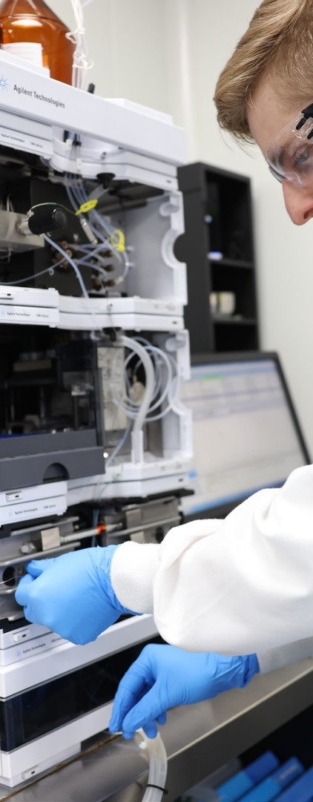




Operational highlights
Growth opportunities remain attractive
In-market team deployed in Australia
to accelerate penetration of Penthrox in hospital emergency departments
Penthrox volumes in France up 24%
but below expectation, with challenges across the health system
Strong growth in partner markets
Penthrox relaunched in Canada, demand in UK and Ireland up 29%
Market share gains in the Respiratory segment
sales in the USA up 100%
Planning for Penthrox USA market entry underway
focus on future partnering potential
4

Slide 5


FINANCIAL PERFORMANCE

Slide 6

Earnings summary
FY23 half year results
$million | 1H22 | 1H23 | Change %
Revenue¹ | 9.6 | 13.9 | 45%
Underlying EBIT | (8.5) | (8.1) | 4%
Underlying Adjustments² | (0.9) | 11.5 | -
Reported EBIT | (9.4) | 3.4 | -
NPAT | (7.4) | 2.7 | -
Commentary
Higher volumes in both Pain Management and Respiratory segments
Price increases successfully implemented
Continuing investment in resources to drive growth strategy
Underlying EBIT improved
Non-cash Underlying Adjustments of $11.5 million (gain) mostly arising form cessation of clinical trial preparations in China
NPAT strongly improved due to non-cash Underlying Adjustments
Excludes Contract termination revenue of $18.9 million (refer to the Half-Year Consolidated Financial Report)
Underlying adjustments in the current period included: contract termination revenue arising from the termination of agreements for the distribution of Penthrox in China ($18.5 million); and im- pairment of capitalised registration costs following the cessation of market activities in China of $6.5 million, and an additional $0.9 million in other countries where revenue opportunities are not being pursued. Underlying adjustments in the prior period related to impairment losses recognised following the Group’s decision to discontinue the Veterinary business ($0.6 million); and finali- sation costs for the CSIRO Continuous Flow technology program ($0.3 million).
6

Slide 7
Revenue and volume
Strong revenue and volume growth
Commentary
Pain management revenue up 27%
France volumes up 24% against a challenging economic backdrop
In-market volumes up 29% in UK and Ireland, though revenue impacted by timing of deliveries
Solid demand from ambulance in Australia
Relaunch of Penthrox in Canada
Prices increased
Underlying revenue ($million)
1H22
1H23
Change %
Product revenue
Milestone and other revenue
5.9
0.1
7.0
0.6
19%
-
Pain Management | 6.0 | 7.6 | 27% | •
Respiratory | 3.4 | 6.2 | 81%
Other | 0.2 | 0.1 | - | •
Group | 9.6 | 13.9¹ | 45%
 |  |  |  | •
Pain Management
Penthrox units² 000s
Respiratory
Revenue ($million)
153
147
2.5
2.5
Respiratory revenue up 81%
Strong market share growth, particularly in USA
Prevalence of respiratory conditions during winter driving solid underlying demand
Prices increased
117
1.6
89
65
1.1
1.2
20
0.4
0.1 0.1
ROW
Europe¹
Australia
ROW
Europe
1H23
Australia
USA
1H22
7
Excludes Contract termination revenue of $18.9 million (refer to the Half-Year Consolidated Financial Report)
European volumes reflect “in-market” sales units, which may differ from units sold to distribution partners in the period (and recognised in revenue). The Company believes this measure improves the transparency of underlying demand.

Slide 8
EBIT bridge
Volume and pricing drive margin improvement
Commentary
Higher Penthrox volumes, improved pricing and higher milestone income in Pain Management
Strongly improved volumes in Respiratory, and disciplined margin management
Investment in commercial, leadership and functional capability to support growth initiatives
Other cost changes include benefit of one-off share-based payments expense adjustment arising from implementation of new Long Term Incentive Plan for senior managers and inflationary impacts
Underlying EBIT bridge ($millions)
Gross margin improvement
Investment in commercial and functional capability to support growth initiatives
1H22 Underlying EBIT loss
Pain management volume & margin
Respiratory
volume & margin
Australian expansion
Respiratory growth
Functional support
Other cost changes
1H23 Underlying EBIT loss
(8.5)
(8.1)
1.2
(1.0)
(0.4)
1.2
(0.8)
0.2
8

Slide 9
Balance sheet and cashflow
Investment to support growth
Commentary
Improvement in customer collections
Investment in inventory to support growth in both Pain Management and Respiratory segments
Cash on hand of $37.1 million
The change in operating cashflow versus the pcp reflects higher investment in working capital
Capital expenditure includes spend related to the Company’s manufacturing operations, and trial and registration activities
Key balance sheet items
$million | FY22¹ | 1H23 | Change $m
Trade receivables | 6.1 | 5.7 | (0.4)
Inventory | 7.1 | 10.6 | 3.5
Trade payables | (9.4) | (10.7) | (1.3)
Trade working capital | 3.8 | 5.6 | 1.8
Cash at bank | 20.4 | 37.1 | 16.7
Key cashflow items
$million | 1H22 | 1H23 | Change $m
Operating cash flow | (5.0) | (9.0) | (4.0)
Capital expenditure | (3.0) | (2.8) | (0.2)
9
1. 30 June 2022

Slide 10
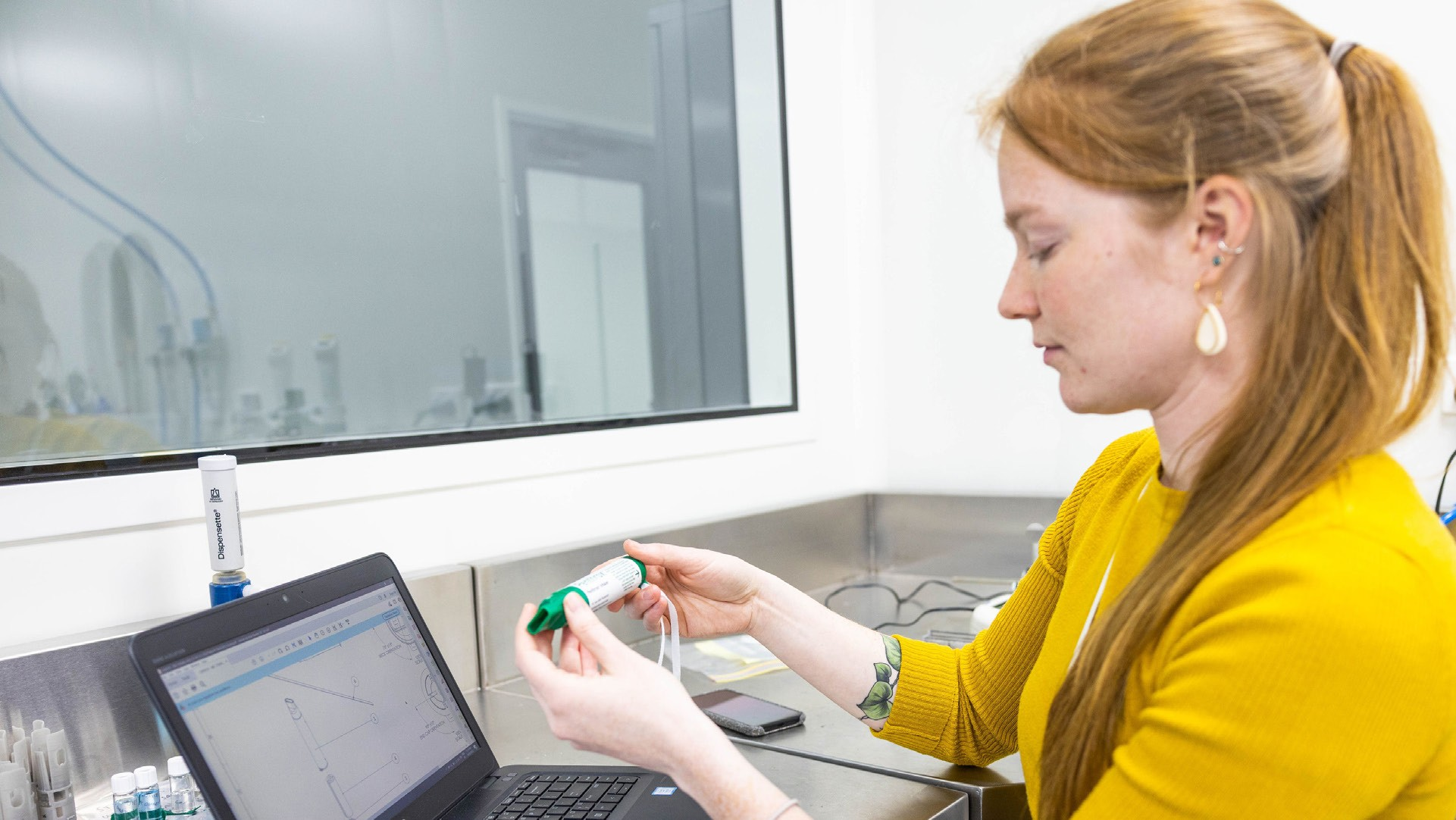
FY23 PRIORITIES AND OUTLOOK

Slide 11

France growth strategy
Attractive growth opportunity for Penthrox
Positive customer feedback despite challenging conditions
Ease of use and resourcing efficiency differentiate Penthrox
Attractive customer base with >300 existing customers
Volume growth of 24% in 1H23 with annual run rate of ~60,000 units
Challenging conditions slowing progress
-Severe staff shortages, hospital budgetary constraints
-Difficulty retaining and recruiting key account managers
11

Slide 12
Australian business expansion
Drive penetration in emergency departments
Field team deployed, will drive deeper and broader market penetration
Attractive market opportunity¹
Procedural
17%
Ambulance
31%
In-market team recruited and deployed
New marketing campaign launched
-Supporting positioning of Penthrox in emergency department and procedural settings
Large and attractive market opportunity
-Hospital emergency departments
-Short surgical procedures
-Ambulance
Outpatients
7%
Public Emergency Departments
45%
Percentage services by segment
Opportunity to broaden market penetration
~75% of Penthrox volumes currently from Ambulance segment
Significant opportunity to grow in emergency departments and procedural
12
1. Productivity Commission 2021, AIHW 2021, AIHW 2020, Services Australia Medicare Item Reports 2021, PENTHROX Qualitative Research 2021. Paramedics/Ambulance Officers & Emergency Physicians; PENTHROX Quan- titative Market Research 2022.

Slide 13

Partner growth strategy
Momentum building
Delivering success in new and existing markets
Continued growth in UK and Ireland, monthly in-market Penthrox volumes achieving new thresholds
Re-launch of Penthrox in Canada with motivated new partner, strong forecast demand with additional shipment ordered for the 2nd half
Strong partner engagement, sales into over 20 markets globally
Opportunity to reset commercial arrangements
13

Slide 14
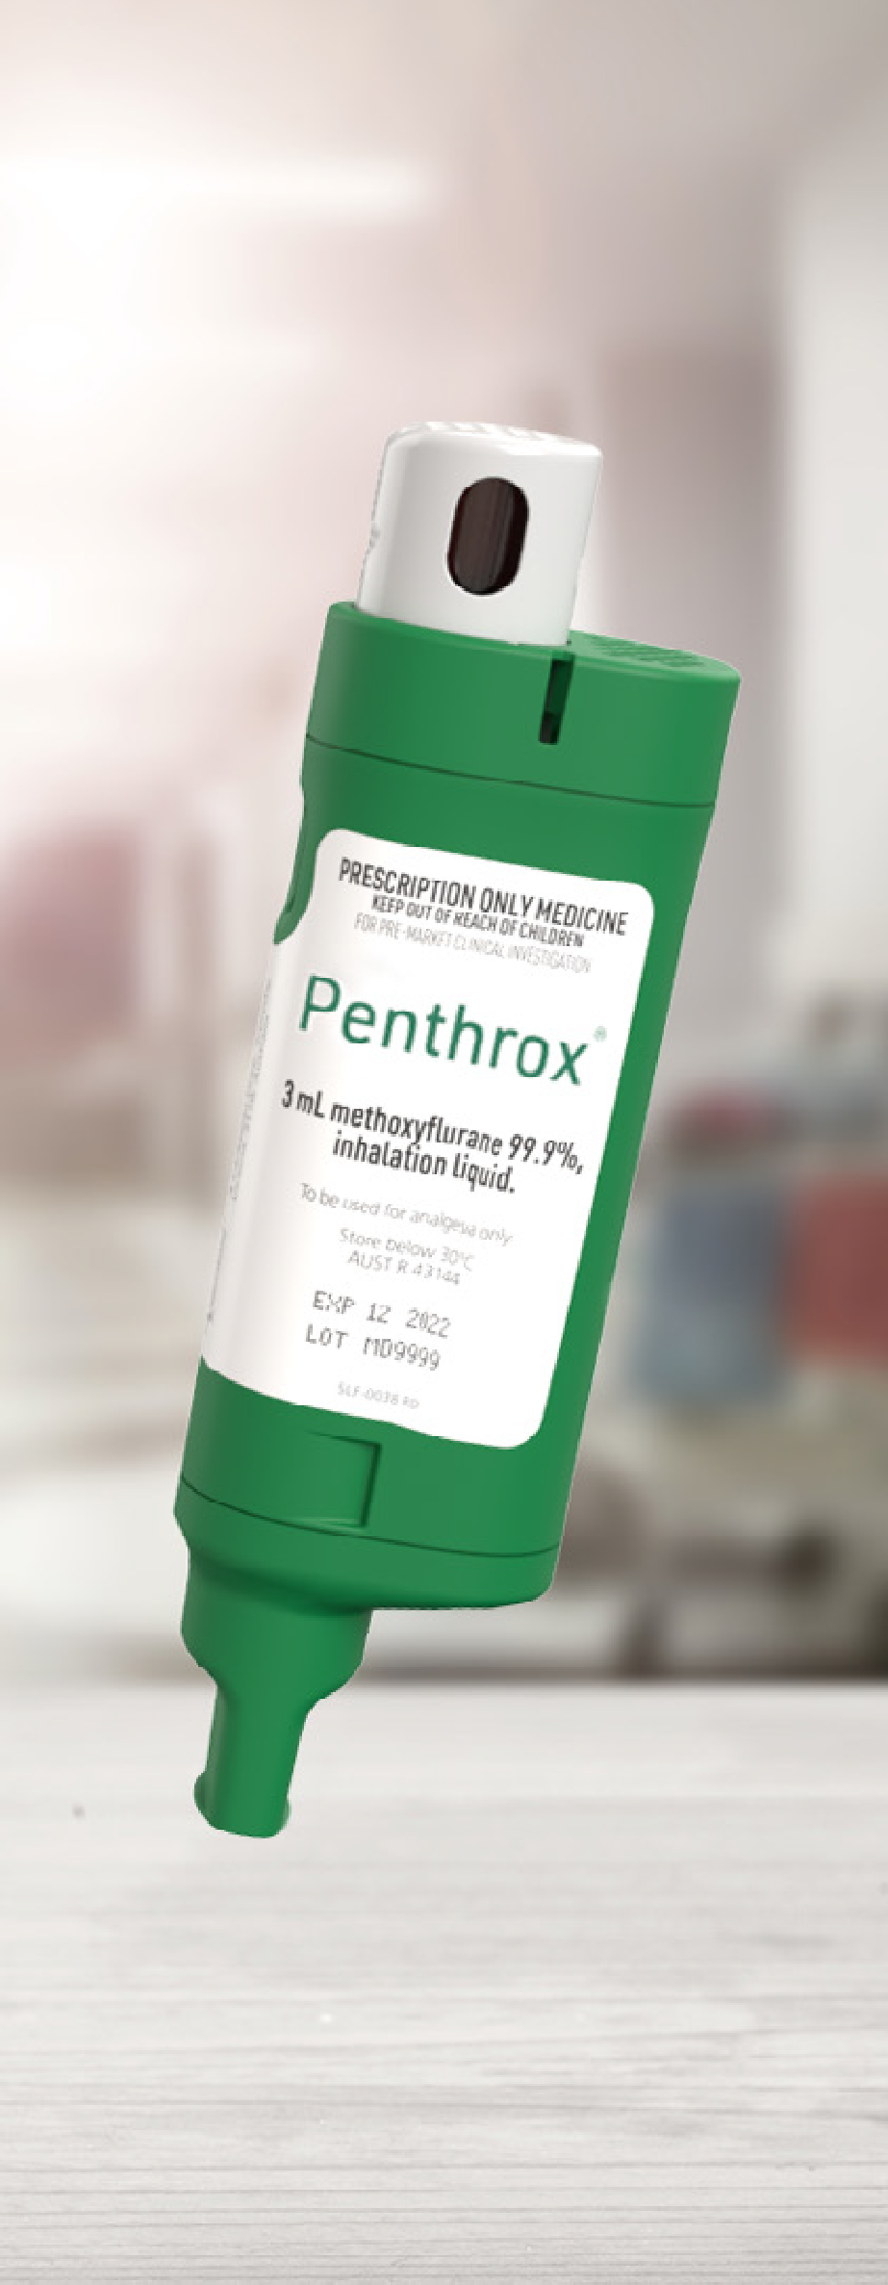
USA market entry
Plans advancing
The USA will drive a new wave of expansion succeeding the current European and Australian growth
Detailed commercial market assessment underway to inform:
-Addressable market and commercial pathway
-Resource requirements to access
-Potential partners
Clinical program advancing
-Protocol reviewed to broaden opportunity
Development of next generation device, to be used at launch, on track
-New device will deliver improved usability
Funding strategy focused on partnering and / or other 3rd party funding arrangements
14

Slide 15

FY23 priorities
Growth in the 2nd half
Pain Management
Complete US commercial market assessment and advance funding plan
Accelerate growth in France
Grow in Australian hospital emergency departments
Positive momentum to continue in partner markets
-Re-launch in Canada
-Continue growth in UK and Ireland
Deliver improved 2nd half operating cashflow
Respiratory
Continue to grow market share
15

Slide 16

Appendix

Slide 17
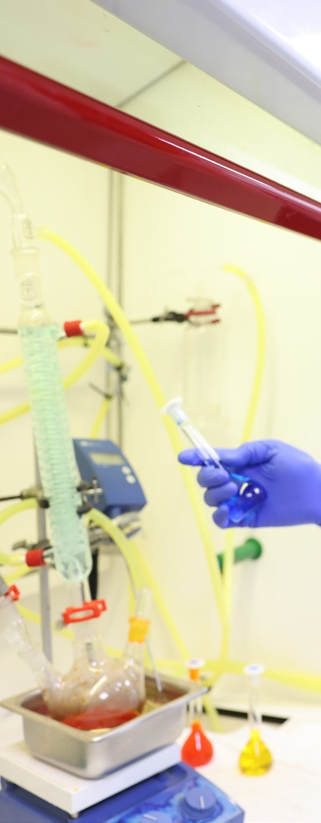
Company overview
Medical Developments International Limited (ASX:MVP) is an Australian based pain management and respiratory company
The Company’s lead product Penthrox (The Green Whistle®), an inhaled, needle- free, non opioid analgesic, is manufactured in Australia and sold globally
The Company also has a portfolio of respiratory products for sufferers of asthma and COPD1
The Company’s strategic focus is to accelerate penetration of Penthrox through direct in-market capability in Australia and Western Europe, and to grow its Respiratory segment through market share gains
Longer term growth for Penthrox will be underpinned by entry into the USA market
17
1. Chronic Obstructive Pulmonary Disease

Slide 18
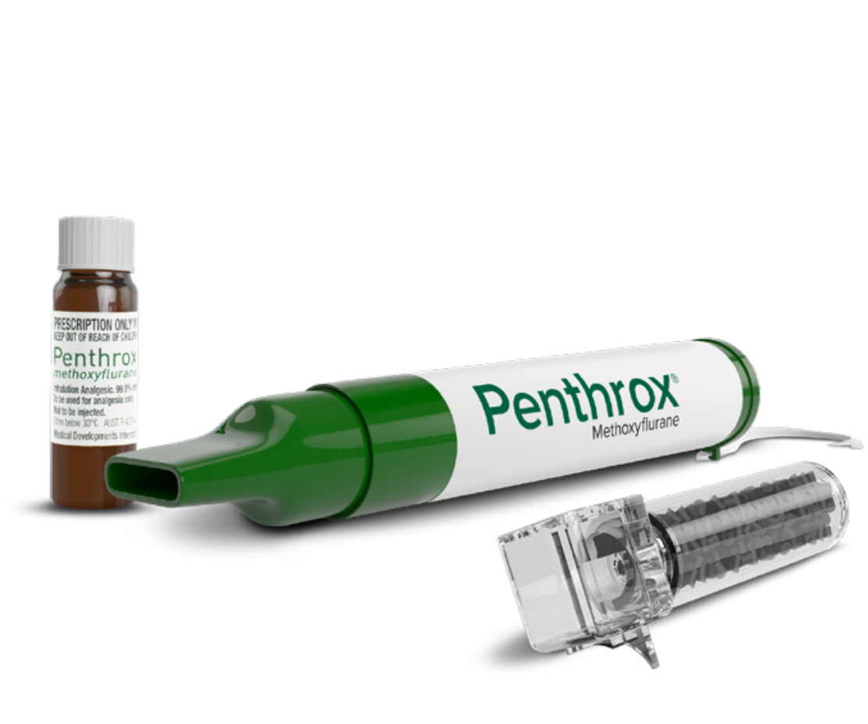
Penthrox
Over 8 million used worldwide
The superior efficacy, safety and administration
benefits of Penthrox deliver improved patient outcomes and lower overall costs
Inhaled needle-free analgesic¹
Non-opioid¹
Portable, self administered device¹
Effective pain relief within 6–10 breaths¹⁻⁴ and rapid offset
Established safety profile with over 8 million uses
Well tolerated, with the majority of adverse events mild and transient^{1,2}
Approved for use in children in Australia¹
Efficiency benefits of Penthrox in hospital emergency departments illustrated in British study⁵
The iconic Green Whistle
18
1. Penthrox® (methoxyflurane) Approved Product Information 13 December 2019. 2. Coffey F, et al. Emerg Med J 2014;31:613-618. 3. Grindlay J, Babl FE. Emerg Med Australasia 2009;21:4-11. 4. Penthrox® (methoxyflurane) Consumer Medicine Information February 2020. 5. Craigavon, N.I., An inhaled analgesic 31 March 2020

Slide 19
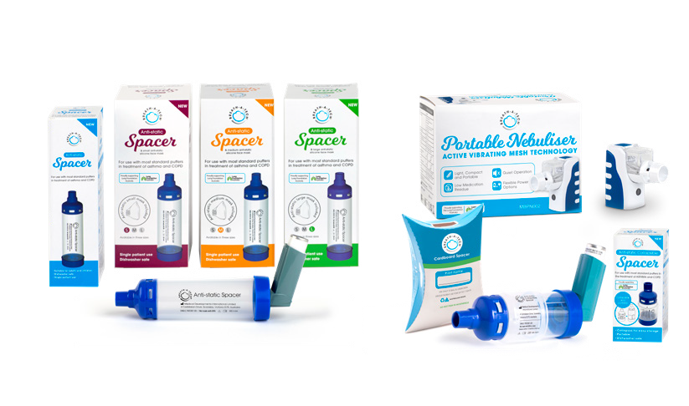
Respiratory
Assisting patients manage asthma and COPD¹
Providing pharmacies, medical clinics and hospitals with a range of respiratory
devices which assist patients to manage asthma and COPD¹
At home On the go
Space chambers
Portable nebulisers
Silicon Face Masks
19
1. Chronic Obstructive Pulmonary Disease

Slide 20
ASX:MVP
FY23 Half Year Results
24 February 2023

